Slide 1
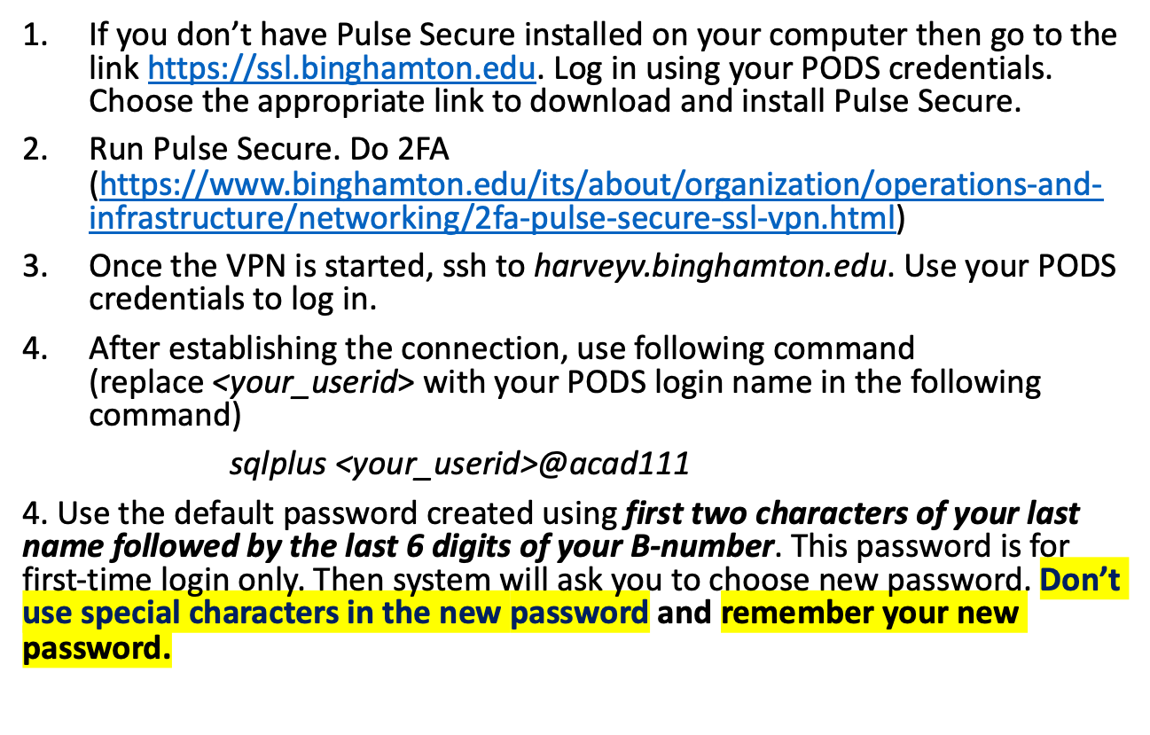
How to connect to the Oracle server?

Slide 2
Oracle Account (1)
The university’s Oracle Server is running on a Linux server (harvey).
You should first log on to your harvey account (userid and password should be the same as those for your BU email account).
You can SSH (secure shell) to harvey:
harveyv.binghamton.edu

Slide 3
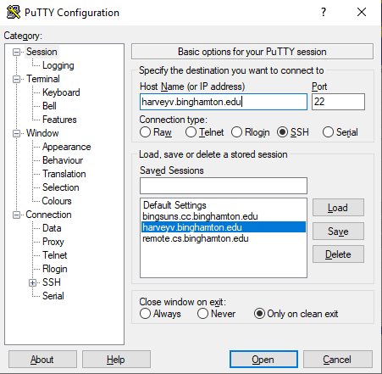
In a Windows machine, use PuTTY to connect to harvey (1)

Slide 4
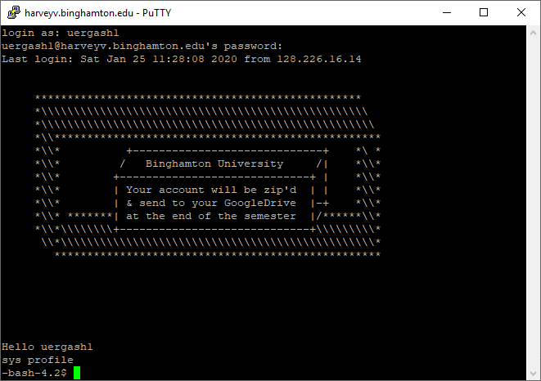
In a Windows machine, use PuTTY to connect to harvey (2)

Slide 5
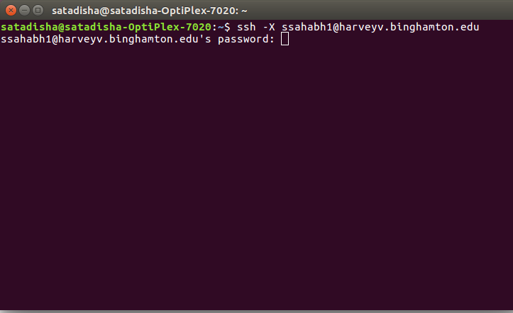
In Linux or Mac, open the terminal and ssh to harvey:
Run command:
  ssh –X <your_username>@harveyv.binghamton.edu

Slide 6
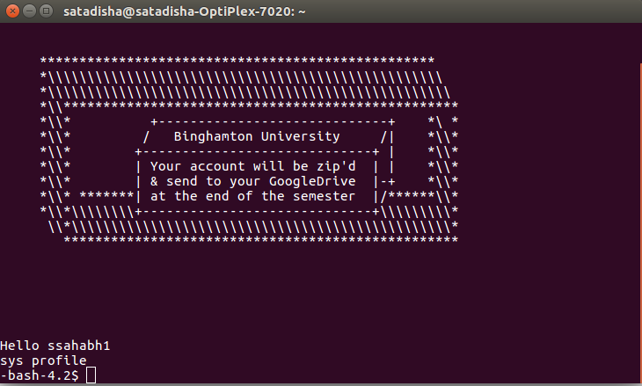
Once you logged in

Slide 7
U-Drive
You will need U-Drive to save your work
You can request U-Drive at: https://binghamton.service-now.com/sp?id=sc_cat_item&sys_id=08ec825bdb69ab00ac639ee5db9619d4
After you request U-Drive, you can manually mount U-Drive from a Windows OS or Mac OS
For complete information for U-Drive, visit: https://www.binghamton.edu/its/helpdesk/u-drive.html

Slide 8
Your Oracle User Name and Password
Information about your Oracle account:
  user name: same as your user id on harvey
  password: first two characters of your last name followed by the last 6 digits of your B-number (no space in between)
  Example: For a user with
  Last name = Smith and B-number = B00987654
  ➔ the password would be: sm987654
  Your password expires after you login for the first time.
    Change your password immediately!
    Don’t use any special character in your new password! Otherwise, you can’t log in later.

Slide 9
Oracle SQL*Plus
Enter Oracle’s SQL*Plus Environment:
-bash-4.2$ sqlplus <your_userid>@acad111 <return>
Enter password: xxxxx <return>
SQL>
Change password following the prompt.
Notes:
SQL> alter user userid identified by newpasswd;

Slide 10
Simultaneous Sessions
BU’s Oracle server allows you to open at most 3 simultaneous sessions. If you failed to terminate your sessions appropriately, you may be blocked from starting a new session.
You can find your active sessions (process #) from your harvey account by:
-bash-4.2$ ps -edf | grep userid <return>
and the kill the ones you don’t need by:
-bash-4.2$ kill process# <return>

Slide 11
SQL*Plus Environment (2)
Three types of commands can be entered following the prompt SQL>.
  SQL statements
  SQL*Plus commands
  PL/SQL blocks
We will focus on the first two types for now.

Slide 12
SQL*Plus Environment (3)
Simple example: create a table of students, insert values
  Delete table: it’s fine that you may get an error if students table doesn’t exist
    SQL> drop table students;
  Create table:
    SQL> create table students(sid char(4) primary key, firstname varchar2(15) not null, lastname varchar2(15) not null,age number);
  Insert values
    SQL> insert into students values ('B001','Bob','Smith',19);
    SQL> insert into students values ('B002','Tom','Broder',20);
  Select values from table
    SQL> select * from students;

Slide 13
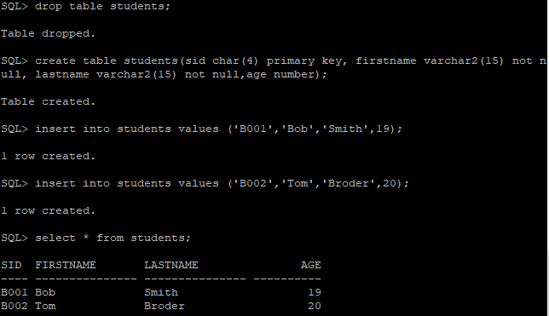
SQL*Plus Environment (5)
Output of the examples

Slide 14
SQL*Plus Environment (6)
Three ways to terminate an SQL statement:
  with a semicolon ;
  with a slash / on a line by itself
  with a blank line
; and / will execute the statement and save the statement in the SQL*Plus buffer.
A blank line saves the statement in buffer.

Slide 15
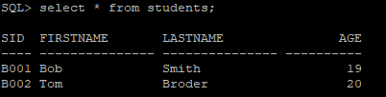
SQL*Plus Environment (4)
Examples:
SQL> select * from students;
or SQL> select * from students
2 /
or SQL> select * from students
2
Output:

Slide 16
SQL*Plus Environment (7)
Most recently executed SQL statement will be saved into the SQL*Plus buffer.
Use list to display buffer content.
Use / or run to execute the statement in buffer.
  run list buffer content before executing it.
Use save test to save the buffer content into a host file test.sql.
Use clear buffer to clear the buffer.
Use get test to bring host file test.sql into the buffer.

Slide 17
SQL*Plus Environment (8)
A SQL*Plus command terminates with the <return> or <enter> key.
More common SQL*Plus commands:
  describe table_name: display the definition of the table
  start test (or @test): execute the statement in host file test.sql

Slide 18
SQL*Plus Environment (9)
  host (or !): enter the host operating system shell (use exit to quit the shell)
  host command (or !command): execute a host operating system command
Example: SQL> !pico test.sql
  define _editor = pico: define your default editor to be pico
  edit test: edit host file test.sql
  edit: save buffer content into file afiedt.buf and enter the edit mode.

Slide 19
SQL*Plus Environment (10)
  spool filename: save subsequent SQL*Plus commands, SQL queries, and query results into a host file.
  spool off: close the spool file.
  exit: quit SQL*Plus.
  help index: find all SQL*Plus commands
  help command_name: find information about a command.

Slide 20
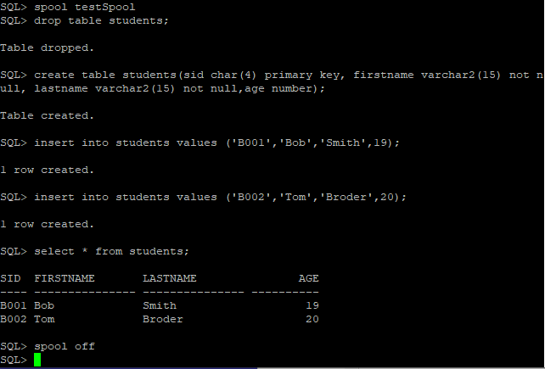
Spool example

Slide 21

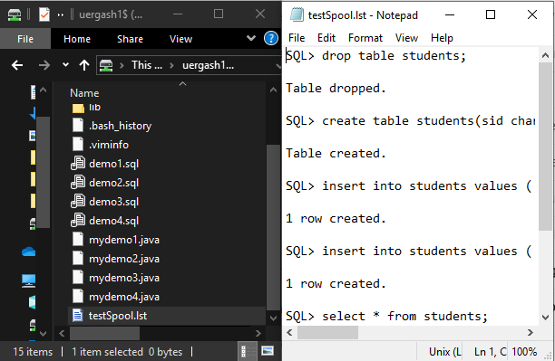
Spool file on the disk
Spool file on U-Drive

Slide 22
SQL*Plus Environment (11)
Use set to customize the environment:
set echo on: list the statement before executing it when using start
set pause on: display result page by page
set pagesize 100: each page has 100 lines
set linesize 170: each line has 170 characters
use show all to see all set variable values
use host file login.sql to save customized settings and other commands

Slide 23
SQL*Plus Environment (12)
Use Column Format to control display of results:
column column_name heading column_heading format format_mask
  Format_mask examples
  a20: 20-character wide
  99999: 5 integer digits, e.g., 123, 1234, 12345
  9999.00: 4 integer digits and 2 decimal digits, e.g., 123.45
column bdate heading Birthdate format a10: make column bdate displayed as Birthdate with 15-character column width
column deptname heading “Department Name” format a15: “ ” is needed for new heading with space
Use clear columns to reset the format

